Slide 1
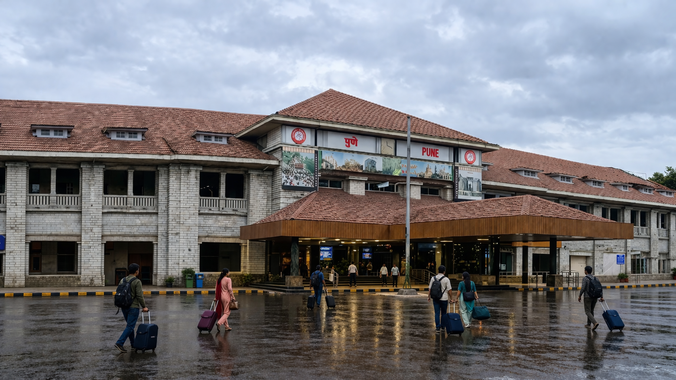

Pune Division, CR
Welcomes
Shri RAJEEV SHRIVASTAVA
General Manager
Central Railway
23.04.26

Slide 2
Pune Division at a Glance
Route Kilometer | : | 945 km (SL– 340 km & DL– 605 km)
Track Kilometer | : | 1922.56
Total Stations | : | 114
Junction Stations | : | 05
Block Stations | : | 77
Halt Stations | : | 32
Total Bridges | : | 1644
FOBs | : | 65
ROB & RUB | : | 78 & 219
Level Crossings | : | 88 (Non Interlocked - 15)
Operations
No. Of Staff | SS - 13637, MOR - 10444, Vac - 3193 (23.41%)
Average Daily Trains – Coaching | Vande Bharat: 2 (2 Pairs) Mail/Exp : 138 Pass : 80 Total: 223.43
AVG Daily Trains – Goods | 120 (Runs)
Originating Passengers | 65,000 Per Day (Nos.)
Interchange | 114 Trains Per Day (Highest– 115)
Divisional Wagon Balance | 4200
Coach Holding | 932
Section |  | Kilometer
LNL– Pune – Daund | : | 136.18 km
Pune (Excl) – Miraj | : | 276.17 km
Miraj – Kolhapur | : | 47.10 km
Lonand – Phaltan | : | 25.98 km
Daund – Ankai | : | 227.38 km
Puntamba – Shirdi | : | 16.7 km
Ahmednagar – Beed | : | 172.5 km
Daund – Baramati | : | 42.82 km
Assets Installations
Diesel Shed / Pune | 245 (Elec– 101 & DSL- 144)
Electric Loco Shed / Daund | 50 (Loco Holding)
ROH | DAUND
Coaching Depot | pune, KOP, MRJ
Freight Depot | MRJ
Lobby & Running Room | 9 (Pune, GPR, STR, MRJ, KOP, DD, ANG, pb & SNSi)
Real Estate No. of Quarters Land Holding (in Hectares) Land Covered by Service Building (in Hectares) | 4296 5067.092 36.40

Slide 3
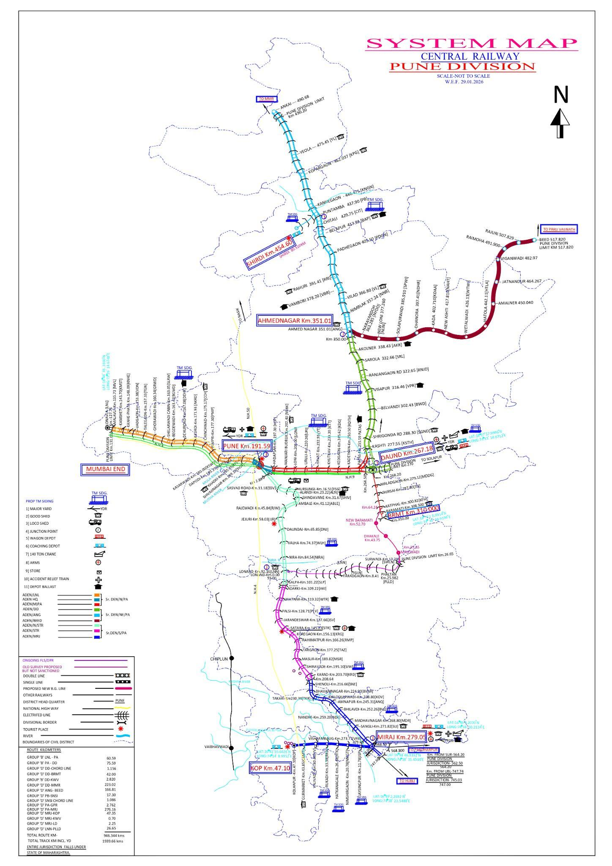
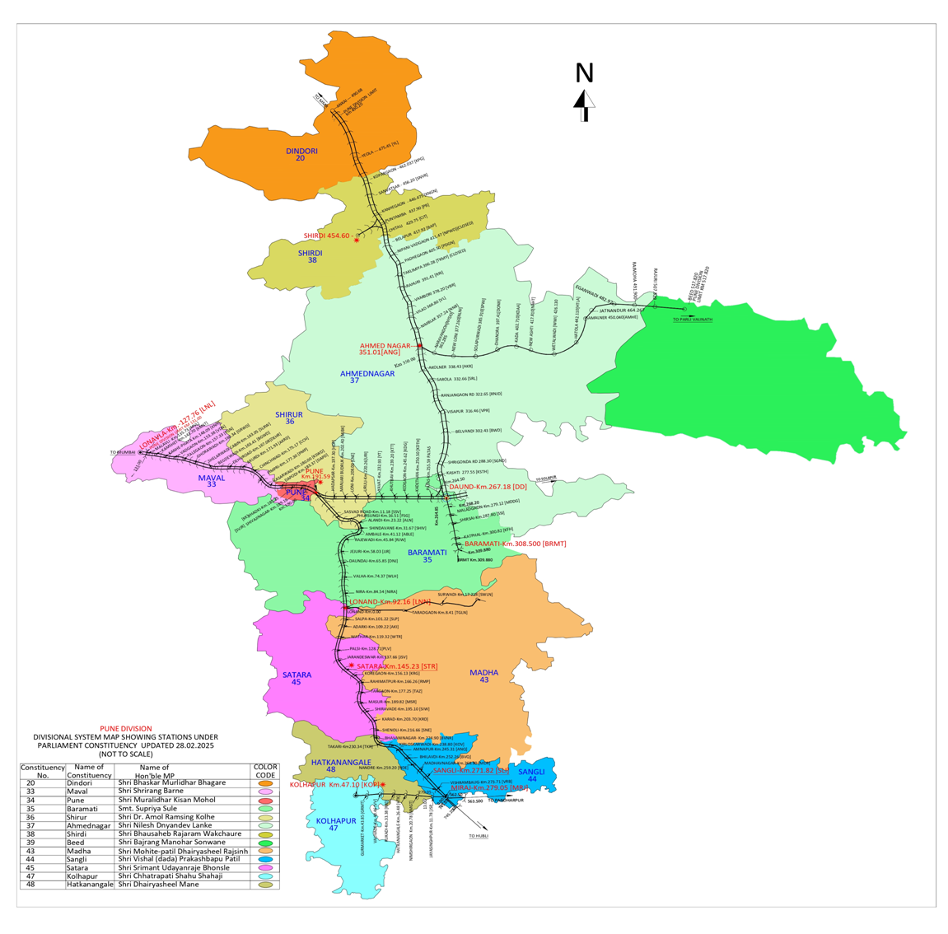
System Map
PUNE Division
w.e.f. 29.01.2026
13 MP Constituency wise map of
PUNE Division

Slide 4
Revenue (Cr) – Projection FY 2026-27
Goods Traffic (T)— Projection 2026-27
Year | 2024-25 | 2025-26 | Proj- 2026-27
Revenue (Cr) | ₹ 2158.98 | ₹ 2238.57 | ₹ 2,362
Tonnage (MT) | 3.21 | 2.31 | 2.42

Slide 5
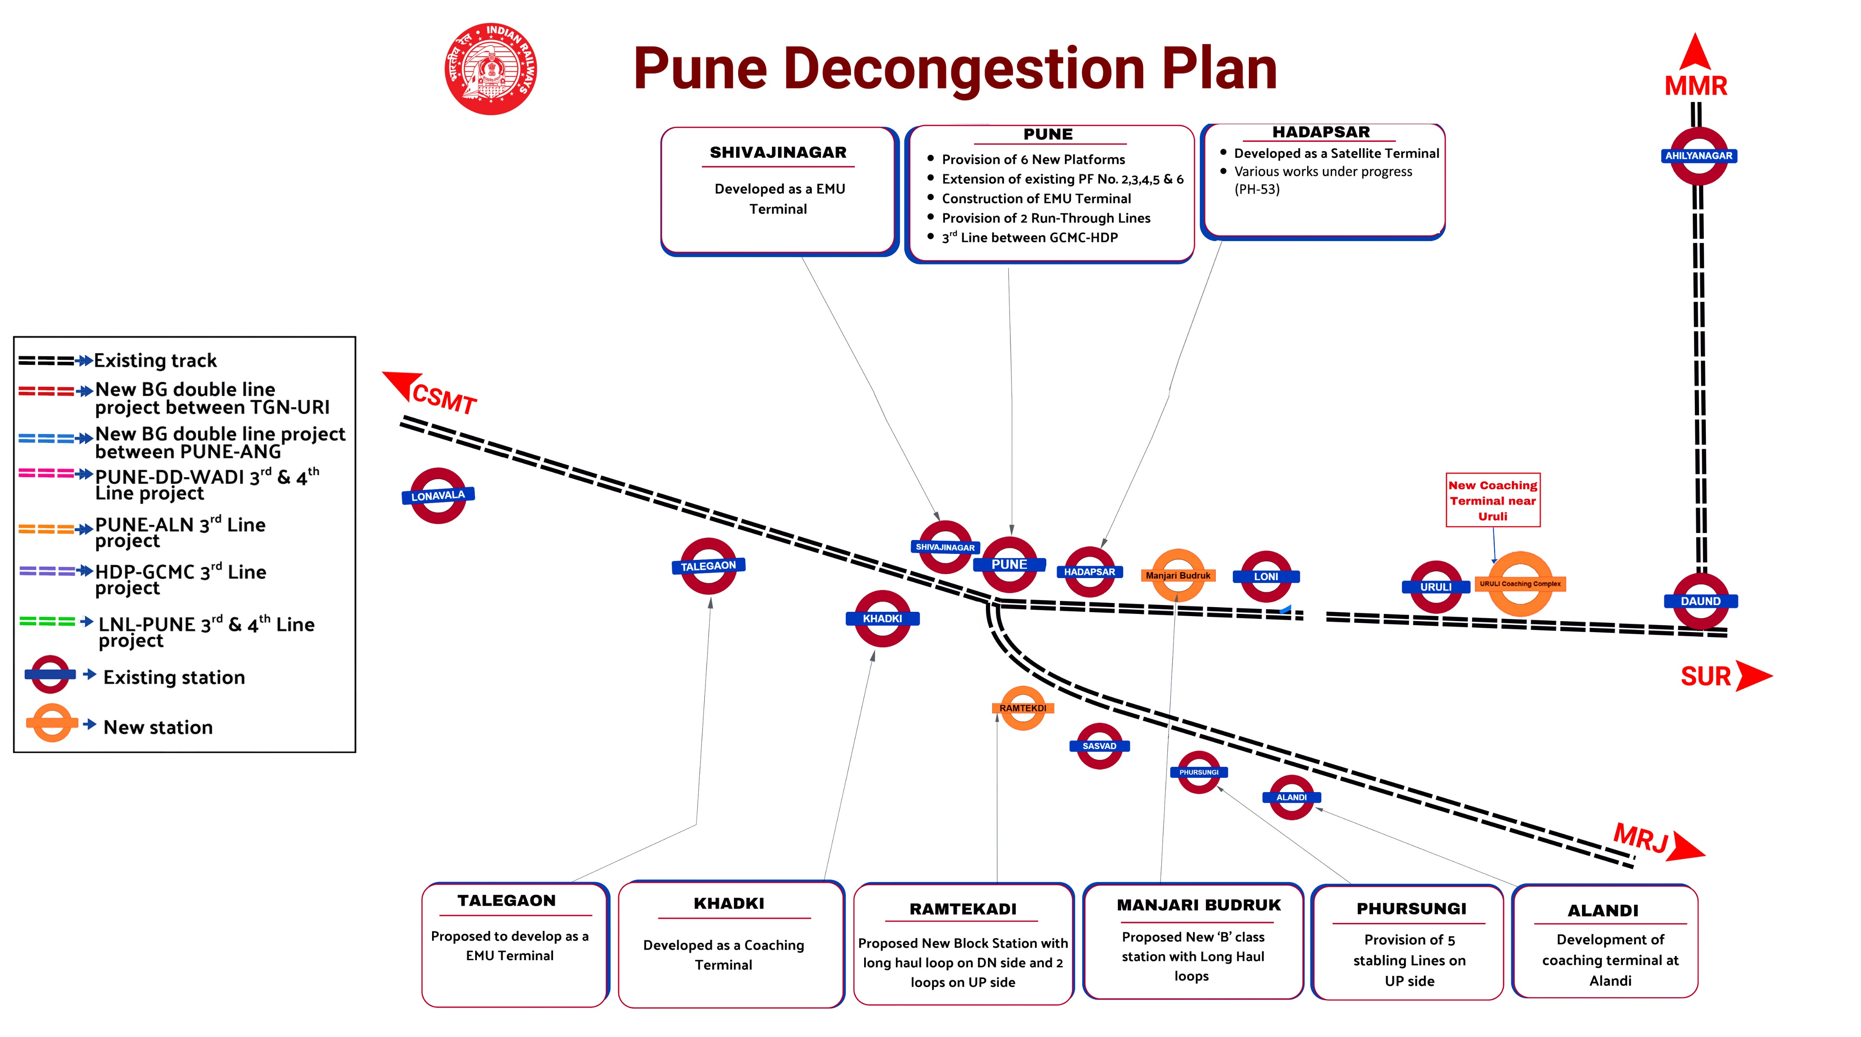

Pune ESP
Map

Slide 6
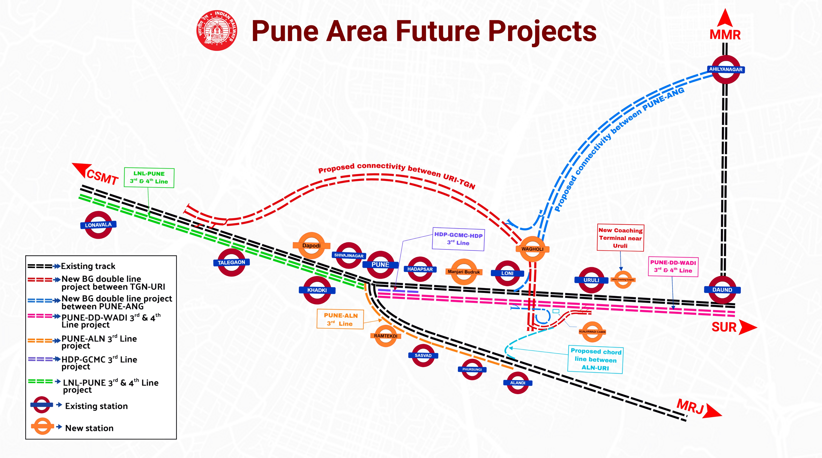

Slide 7
Pune Decongestion Plan
Features
Pune is a major junction station having 6 Platforms dealt train movements from 3 direction i.e. CSMT, MRJ & DD.
Total Average 154 Trains are being handled daily at Pune station.
It is a major point with linking South bound trains with Mumbai.
Average 35 goods trains dealt daily.
Constraints
Only 2 out of 6 platforms can handle trains with 22 LHB & 24 ICF coaches (24 pairs)
Speed restriction of 10 KMPH in Pune yard due to complex yard layout & non-availability of required signal overlap.
8 Double Diamond Crossings (DDS)
3 Single-Slip Switches
1 Ordinary Diamond Crossing
Operational congestion due to:
Backing & berthing of empty rakes
Movement of LOCO’s to & fro trip shed
Shunting of VPUs, sick coaches, inspection coaches
No full-length through goods line, leading to detention of goods trains outside station.
Scattered maintenance facilities (GCMC, NWS, OWS) causing criss-cross rake movements
Sick coaches transfer required from OWS/NWS to GCMC, increasing yard congestion.
Single exit of ARME siding.
Infrastructure limitations:
Alteration in existing RRI is not possible, thus, 3rd line connection to GCMC not feasible before EI commissioning.
Due to difficulty in shifting cables behind GC3 cabin, commissioning of two stabling lines near GC3 cabin is not feasible before EI commissioning.
Decongestion Plan -
Shivajinagar station was developed as an EMU terminal in 2023 with one dedicated EMU handling line.
Khadki and Hadapsar stations are developed as a coaching terminal & both works were commissioned in July 25.
3rd line between GCMC-HDP.
Provision of 5 stabling lines sanctioned at Phursungi in lieu of stabling lines surrendered in Pune yard.
Major Yard Remodeling of Pune Station with EI.
Proposed dedicated EMU terminal with 3 PFs.
Development of Alandi and Uruli as a coaching terminal.
FLS sanctioned for 3rd line between Pune-Alandi stations.
New Block Stations proposed at Ramtekadi (Pune–SSV) and Manjari (HDP–LONI sections).
Notes:
TDC

Slide 8
Pune Decongestion Plan
Shivajinagar station was developed as an EMU terminal in 2023 with one dedicated EMU handling line.
Khadki and Hadapsar stations are developed as a coaching terminal & both works were commissioned in July 25.
3rd line between GCMC-HDP.
Provision of 5 stabling lines sanctioned at Phursungi in lieu of stabling lines surrendered in Pune yard.
Major Yard Remodeling of Pune Station with EI.
Proposed dedicated EMU terminal with 3 PFs.
Development of Alandi and Uruli as a coaching terminal.
FLS sanctioned for 3rd line between Pune-Alandi stations.
New Block Stations proposed at Ramtekadi (Pune–SSV) and Manjari (HDP–LONI sections).

Slide 9
Capacity Augmentation works
LONAVALA - PUNE
PUNE - DAUND
SN | Station | Work | Sanction Date/Cost | TDC
1 | Malavali | Full Length Loop Lines | 2023-24 28.28 Cr | JUN 2026
2 | Talegaon | Goods Shed Facilities | 2023-24 30.55 Cr | AUG 2026
3 | Chinchwad | Goods Shed Facilities | 2023-24 18.71 Cr | MAY 2026
4 | Dehu Road | Extended Loop lines | 2024-25 38.43 Cr | FEB 2027
5 | Dapodi | Extended Loop lines | 2024-25 39.38 Cr | FEB 2027
SN | Station | Work | Sanction Date/Cost | TDC
1 | Hadapsar | Stabling Line with RBPC | 2024-25 18.13 Cr | AUG 2026
2 | Loni | Goods Shed Facilities | 2022-23 47.10 Cr | DEC 2026
3 | Loni | Connection from Proposed Shunting Neck | 2024-25 6.55 Cr | DEC 2026
4 | Uruli | Extended Loop lines | 2024-25 38.32 Cr | FEB 2027
5 | Yevat | Extended Loop lines | 2024-25 38.16 Cr | AUG 2026
6 | Kedgaon | Extended Loop lines | 2024-25 33.06 Cr | FEB 2027
7 | Daund | Infrastructural improvement and capacity augmentation | 2024-25 32.78 Cr | DEC 2026
SN | Station | Work | Sanction Date/Cost | TDC
1 | Ghorpadi | Upgradation/Development into Vande Bharat Chair Car Maintenance cum Workshop depot | 21.07.2023 89.64 Cr | EPC LOA Issued on 09/02/2026
2 | Daund | Extension of ROH Shed | 14.03.2024 / 30.84 Cr | Work in progress.
3 | Daund | Extension of existing pitline by 290m to accommodate full length rakes | 24.03.2025 / 9.47 Cr | Jan, 2027
4 | Ghorpadi | CNC Tandem under floor wheel lathe | 03.09.2024 / 20.32 Cr | Work in progress at GCMC.
PH – 41 & PH – 42 : Major Works

Slide 10
Holding Area at Pune Railway Station
🟡 Temporary Holding Area
(Seasonal Arrangement)
📍 Location: Platform No. 1 (VIP siding)
📐 Area: ~600 sq.m
👥 Capacity: ~1500 passengers
🕒 Usage: During Summer & Festival Rush
Name of works :-
Development of Permanent holding area at Pune Railway station for Rush Management.
Scope of work :
Civil work (Holding area 6400 sqm with PE roof structure).
Security scanners, Ticket counters, CCTV system , Telecom system, Firefighting system, Electrical & Plumbing etc.
Roof top Solar System, etc
Cost - 25.71 Cr
Status- Divisional & PFA concurrence obtained.
Proposal is currently with ED/SD&T Since 20.04.2026 in IRPSM for CRB concurrence.
🔵 Permanent Holding Area
(Planned for Rush Management)
📅 Approval: 08.03.2026 (GM/CR)
📐 Area: ~ 6400 sq.m
🏗️ Status:
Divisional & PFA concurrence obtained
Proposal under review with RITES Ltd (Railway Board compliance)
🛠️ Proposed Amenities
Covered structure (PE Roof)
Ticket Counters
6-meter-wide FOB (Holding Area → Platform)
Toilet Blocks
Security Systems (Scanners & CCTV)
Lighting Facilities
Help Desk / War Room
Telecom Systems

Slide 11
Status of Works related to Decongest Pune Railway Station
SN | Name of the work | Cost (Cr) | PH | Status & TDC if any
Sanctioned works at Hadapsar
1 | Construction of 01 stabling line with RBPC facility. | 18.13 | 16 | TDC: AUG 2026
2 | Construction of HL PF- 4 in available railway land along with passenger amenities | 7.79 | 53 | Tendering under process.
3 | Provision of 06 m wide FOB in Pune end connecting to all PFs. | 14.17 | 53 | Tendering under process.
4 | Provision of lighting & lifts facility to PF- 4 along with OHE mast shifting. | 4.18 | 53 | Tendering under process.
Proposed works at Hadapsar
1 | Additional works ( 2 extended loops) | 45.69 | 16 | Proposed in UW 2026-27.
2 | Construction of Balance HL PF 4 along with land acquisition & passenge amenities | 32.91 | 53 | Currently with CPM-GSU for compliance of RB.
Sanctioned works at Khadki
1 | Provision of Coach guidance board, Train indicator boards, announcement | 3.59 | 53 | DE Under Vetting
2 | Provision of Full-length COP ( 13300 sqm) at PF No 3 & 4 | 15.67 | 53 | DE Under Preparation
3 | Provision of Cabs way, integrated drainage, Placement of U-shaped drains in Parking area | 5.5 | 53 | DE Under Preparation
4 | Provision of Benches, Furniture, security items at new platform | 1.07 | 53 | DE Under Vetting
5 | Provision of Lifts, Escalators, lighting & fan facility | 9.72 | 53 | DE Under Preparation
6 | Provision of 06 m wide FOB at middle of platform along with ramp connecting to all PFs | 16.54 | 53 | Tendering under progress.
7 | Provision of Elevated offices at PF No 04 and passenger amenities at PF No 03 & 04. | 18.06 | 53 | DE sanctioned.
Sanctioned/Proposed works : Pune – Alandi Section
1 | Construction of 05 Stabling lines at Phursungi | 48.89 | 16 | Work sanctioned on 27.03.2026. Executive agency yet to be decided.
2 | Work for Bidirectional signaling in Pune-Sasvad Road section is sanctioned. | 14.13 | 16 | Work sanctioned on 26.08.2025 ESP to be prepared. DE under preparation
3 | Creation of New ‘B’ class station at Ramtekadi in PUNE-SSV block section | 102.05 | 16 | Work proposed for inclusion in PWP 2026-27 Currently with ED(Gati Shakti) traffic in IRPSM
4 | Connection between Stabling Yard towards ALANDI end & UP loop at Phursungi station | 22.58 | 16 | Proposal uploaded in IRPSM
5 | Provision of Third Line between PUNE and Alandi stations | - | - | FLS sanctioned Construction Concept plans are under preparation.

Slide 12
Hadapsar Station – Satellite Terminal
SN | Name of the work | Cost (in Cr) | Plan Head | Status & TDC if any
Completed works at Hadapsar
1 | Hadapsar - Development as satellite terminal. | 135 | 16 | NI working completed on 20/07/2025.
2 | Provision of RBPC Facilities at Hadapsar station, Pun | 2.49 | 42 | Work Commissioned
3 | Upgradation of Carriage Watering System to Quick watering System at Khadki and Hadapsar Stations | 2.99 | 42 | Work Commissioned
Sanctioned works at Hadapsar
1 | Hadapsar: Construction of 01 stabling line with RBPC facility on DN side towards DD end. | 18.13 | 16 | Sanctioned on 19.05.25. Detailed estimate of ENGG vetted. Tender to be floated. ESP approved. TDC: AUG 2026
2 | Hadapsar - Construction of HL platform no. 4 at Hadapsar Railway station in the available railway land along with COP, Toilet block, Water stand, Telecom facilty | 7.79 | 53 | Work sanctioned on 06.03.2026 Detailed estimate sanctioned. Tendering under process.
3 | Hadapsar - Provision of 06 m wide FOB in Pune end connecting to PF No 1, 2/3 & 4 at Hadapsar station. | 14.17 | 53 | Work sanctioned on 06.03.2026 Detailed estimate sanctioned. Tendering under process.
4 | Hadapsar - Provision of lighting and lifts facility to PF no 4 along with OHE mast shifting work at Hadapsar station | 4.18 | 53 | Work sanctioned on 16.03.2026 Detailed estimate sanctioned. Tendering under process.
Proposed works at Hadapsar
1 | Hadapsar -additional works ( 2 extended loops) | 45.69 | 16 | Proposed in UW 2026-27. Proposal uploaded in IRPSM.
2 | Construction of Balance HL platform no. 4 along with land acquisition and passenger amenities | 32.91 | 53 | Divisional & PFA concurrence obtained. Currently with CPM-GSU for compliance of RB observations

Slide 13
Khadki Railway Station
SN | Name of the work | Cost (Cr) | Plan Head | Status & TDC (if any)
Completed works at Khadki
1 | Provision of additional platform in Up side for RBPC trains / EMUs. | 34.8 | 16 | NI working completed on 13/07/2025.
2 | Provision of 2nd entry with all passenger amenities | - | 53 | Completed in the variation of GSU work
3 | Upgradation of Carriage Watering System to Quick watering System | 2.99 | 42 | Work Commissioned
Sanctioned works at Khadki
1 | Provision of Coach guidance board, Train indicator boards, announcement | 3.59 | 53 | DE Under Vetting
2 | Provision of Full-length COP ( 13300 sqm) at PF No 3 & 4 | 15.67 | 53 | DE Under Preparation
3 | Provision of Cabs way, integrated inlet outlet water & waste water connection, Placement of U-shaped drains in Parking area | 5.5 | 53 | DE Under Preparation
4 | Provision of Benches, Furniture, security items at new platform | 1.07 | 53 | DE Under Vetting
5 | Provision of Lifts, Escalators, lighting & fan facility | 9.72 | 53 | DE Under Preparation
6 | Provision of 06 m wide FOB at the middle of the platform along with ramp connecting to all platforms | 16.54 | 53 | DE sanctioned. Tendering under progress.
7 | Provision of Elevated offices at PF No 04 and passenger amenities at PF No 03 & 04. | 18.06 | 53 | DE sanctioned.

Slide 14
Pune – Alandi Section : Sanctioned / Proposed Works
Sr. No. | Name of the work | Cost (in Crs.) | Plan Head | Agency | Status
1 | Construction of 05 Stabling lines at Phursungi | 48.89 | 16 | To be fixed | Work sanctioned on 27.03.2026. Executive agency yet to be decided.
2 | Work for Bidirectional signaling in Pune-Sasvad Road section is sanctioned. | 14.13 | 16 | Open line | Work sanctioned on 26.08.2025 ESP to be prepared. DE under preparation
3 | Creation of New ‘B’ class station at Ramtekadi in PUNE-SSV block section | 102.05 | 16 | - | Work proposed for inclusion in PWP 2026-27 Currently with ED(Gati Shakti) traffic in IRPSM
4 | Connection between Stabling Yard towards ALANDI end and UP loop at Phursungi station | 22.58 | 16 | - | Proposal uploaded in IRPSM
5 | Provision of Third Line between PUNE and Alandi stations | - | - | - | FLS sanctioned Construction Concept plans are under preparation.

Slide 15
Alandi Station : Proposed Coaching Terminal
01
03
05
07
06
02
Provision of EI building
06
04
Development of circulating area & Multi level car parking
Provision of 02 Full length Shunting neck cum stabling line
Provision of 09 High-Level Platforms (6 new PFs and extension of existing 3 PFs.)
Provision of 08 Short Stabling lines &
7 full length stabling lines after land acquisition
Provision of 05 PIT lines on UP side & 03 on DN side
Provision of 02 ETR line + 02 Through line + 01 Engine escape
Provision 04 IOH lines with 01 Wheel Lathe line
SN | Name of the work | Cost (Cr) | Plan Head | Status &TDC if any
Works under PH-42: PIT lines, IOH lines, Wheel lathe line & Shunting necks
1 | Provision of covered shed along with maintenance facilities for DEMU/MEMU at Alandi (Sanctioned work) | 28.68 | 42 | Detailed Estimate amounting to Rs. 40.41 Cr sanctioned on 02.02.2026
2 | Development of maintenance siding for NMG/NMGH/NMGHS coach (Sanctioned work) | 90.46 | 42 | Detailed Estimate under process at Construction Dept.
3 | Proposed work under PH-42: 5 PIT lines | - | 42 | Estimate under Preparation.
Works under PH-16: 9 PF lines, 15 stabling lines, Electrification, Land aquisition & Signalling of entire yard
1 | Development of Mega Coaching Terminal at Alandi | 482.75 | 16 | Proposed in PWP 2026-27. Currently with ED(GatiShakti)/Traffic in IRPSM.
Works under PH-53: Construction of platforms, all passenger amenities, Elec Gen portion, circulating area & parking
1 | Development of 9 Platforms along with Passenger Amenities | 128.38 | 53 | Under Approval

Slide 16
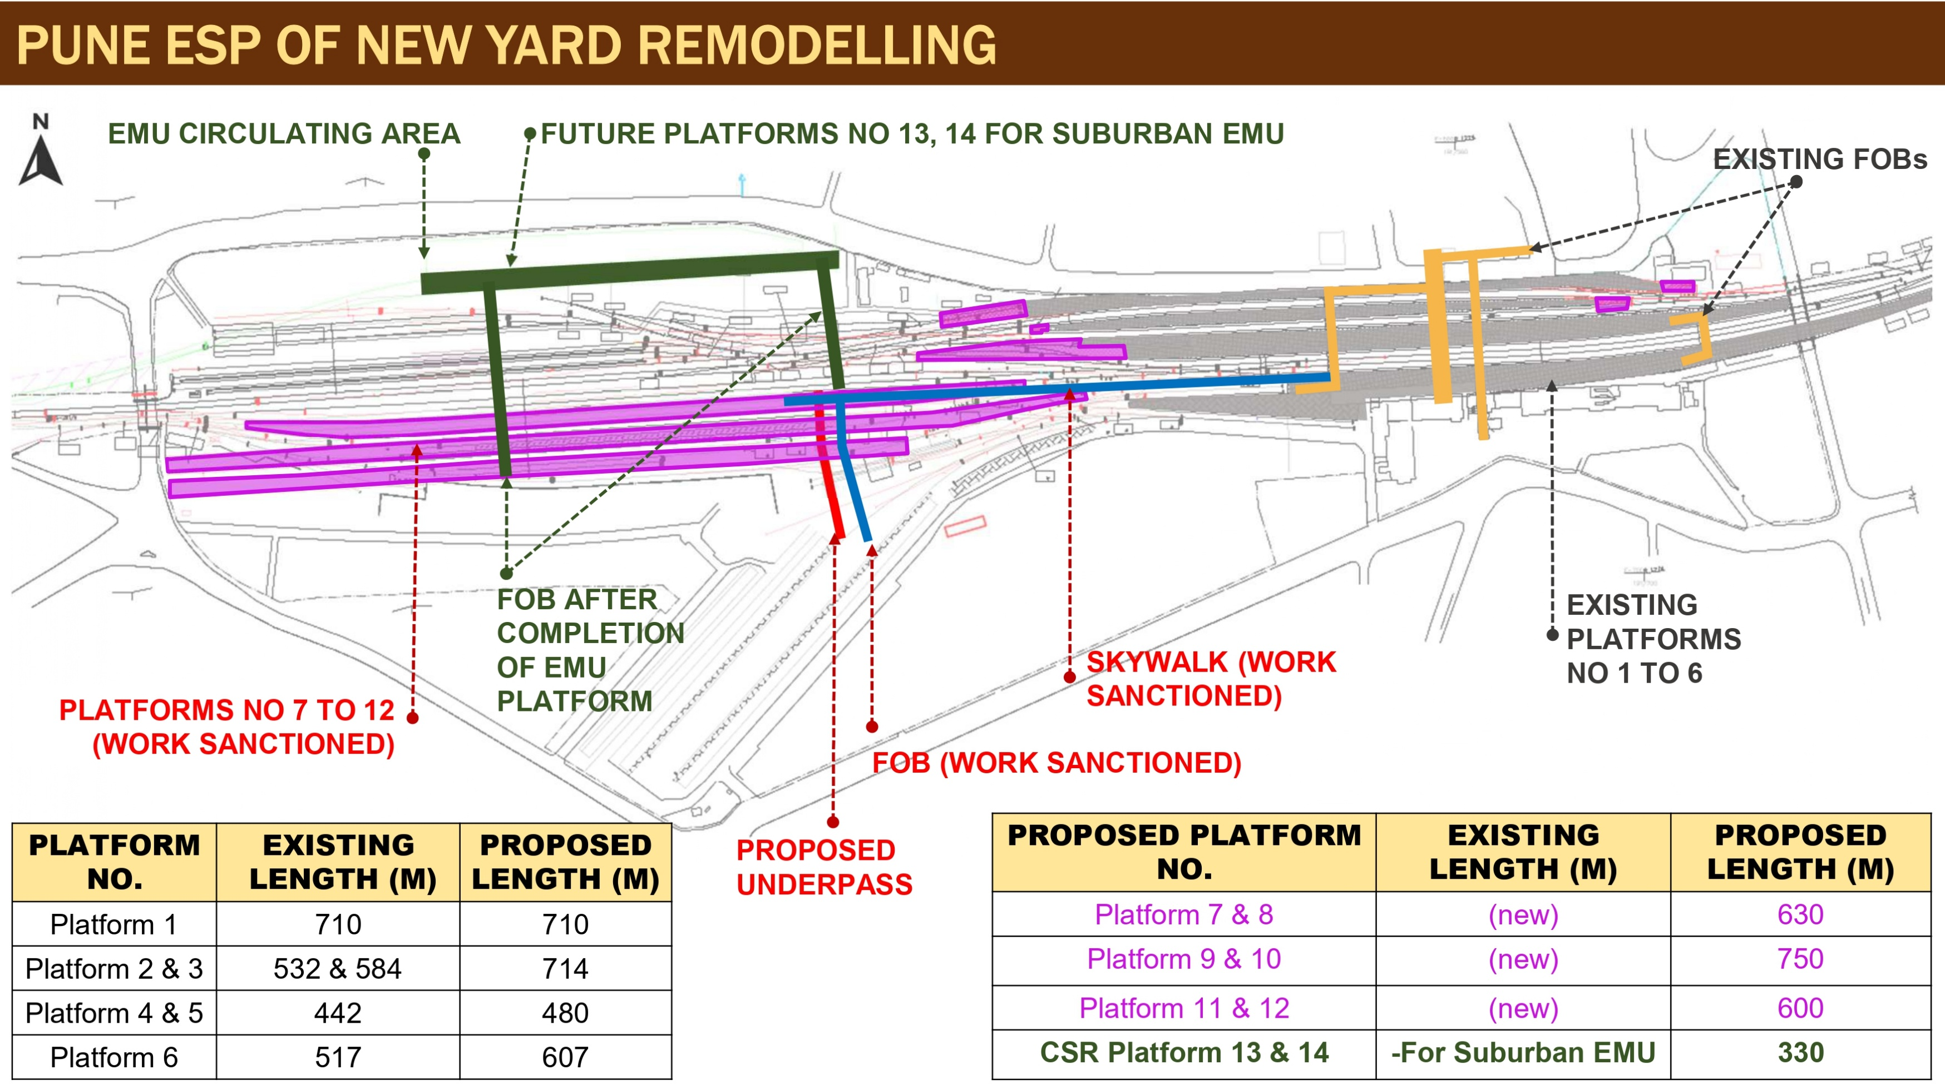

Slide 17
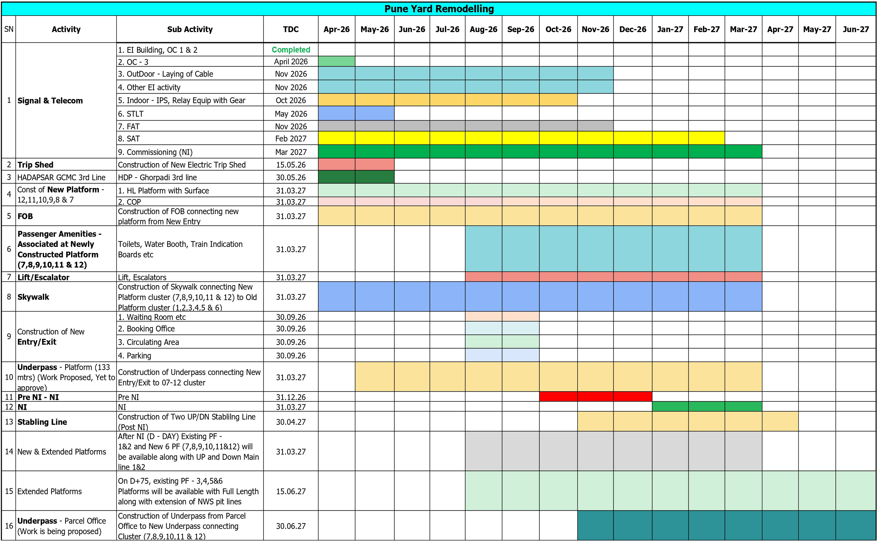
Pune Yard Remodeling: Bar Chart

Slide 18
Highlights of Pune Yard Remodeling work
🚉 Platform Extensions
PF 2, 3, 6 → 24 LHB / 26 ICF
PF 4, 5 → 19 LHB / 20 ICF
➕ New Platforms 6 new platforms (PF 7 – 12) for Full-length Trains
🔌 Trip Shed Relocation Shifting Electric Trip Shed to OWS
🚆 Additional Running Lines Two running behind GC3 cabin
⚙️ Signaling Upgrade RRI upgraded to Electronic Interlocking (EI)
🚶 Passenger Amenities FOB provision for PF 7–12 subway
🔧 Yard Simplification Removal of 12 special track layouts
📉 Optimization Surrender of 8 stabling lines
SN | Description | PH & Cost | Cost in Cr. | Status
1 | Extension of PF 2 to 6 etc. | 16 | 60.35 | Work in progress (Work will be executed in Pre NI, NI & Post NI)
2 | Construction of 3rd line btw GCMC to HDP | 16 | 97.16 | DCN under approval at HQ.
3 | Track Work for new PFs | 16 | 49.43 | Agency in place. Work for construction of PF no. 11 &12 started from 05.04.2026.
4 | Construction of 02 UP & DN run through works near Ghorpadi Cabin | 16 | 28.18 | Agency in place. Due to difficulty in shifting cables behind GC3 cabin & non feasibility of RRI alteration, commissioning of two stabling lines is not feasible before EI commissioning.
5 | Shifting of Trip Shed | 42 | 10.41 | Foundation Work in progress. TDC: 15 May, 2026
6 | Construction of new PFs 7 & 8 | 53 | 10.39 | TOD 25.03.26
7 | Construction of new PFs 9 & 10 | 53 | 19.5 | TOD 25.03.26
8 | Construction of new PFs 11 & 12 | 53 | 15.32 | TOD 25.03.26
9 | Provision of 6 MTR wide Sky walk | 53 | 19.98 | TOD 25.03.26
10 | Provision of 6 MTR vide FOB across new PF | 53 | 15.85 | TOD 25.03.26
11 | Provision of COP on PF 7 & 8 | 53 | 9.47 | TOD 25.03.26
12 | Provision of Lift, Escalator on PF 9,10 & 11 | 53 | 16.04 | Tender opened on 29.01.26. Under TC
13 | Lift, Escalator etc on PF 7 & 8 | 53 | 6.66 | Tender opened on 29.01.26. Under TC
14 | Telecom work for PF 7 & 8 | 53 | 7.98
15 | Provision of subway to connect all new PFs. | 53 | 33.44 | Estimate prepared. Work is being proposed.

Slide 19
Pune Yard Remodeling: Sequence of Execution of the Work
1. Preparatory & greenfield works
2. Commissioning of GCMC–Hadapsar 3rd line (Goods Yard
connectivity) – Target: June 2026
3. Commisioning of Electric Trip shed at OWS. (TDC- 15 May,2026)
Sequence of execution of the work :
1
Surrendered GL line no. 4,5 & 6 with stabling line no. 1 & 2 for construction of proposed island PF no. 11&12 on 05.04.2026. TDC: 65 days
Thereafter, for construction of PF- 9/10 & PF- 7/8, Pune yard lines will be surrendered in phase manner. (For PF 9/10 – GL 1,2,3 &shunting neck: for PF 7/8 – R&D- 4,5,6)
Preparatory work (Six New PFs Construction):
2
1. Construction of Platforms 7–12 (with track)
2. Provision of passenger amenities for PF 7–12
3. COP (commissioning) of PF 7–12
4. Construction of 6 m wide FOB (125 m) + skywalk to existing FOB
5. Development of third entry at Maldhakka end
6. Construction of subway
New Infrastructure Development(Passenger Amenities) :
3
Pre-Non Interlocking (Pre-NI) :
4
Surrender of PF 1 & 2 and UP & DN Main Lines
5
Commissioning of EI (PF 1,2 & PF 7–12 made operational)
Interlocking & Operations :
1. Surrender of NWS and PF 3–6 for platform extension.
2. Commissioning of 2 UP & DN run-through lines behind Ghorpadi Cabin (deferred due to S&T cables).
3. Final connectivity of GCMC–Hadapsar 3rd line with Coaching Yard.
Post-Non Interlocking (Post-NI) :
6

Slide 20
ABSS Phase I Progress
TOTAL SANC. COST
₹461.76 Cr
Cumulative Physical & Financial Progress as on April 2026
SN | Station | Cost (₹ Cr) | Progress % | TDC (Soft) | Target Date of Completion
1 | Baramati | ₹11.40 | 100% | 30.09.2025 | Completed
2 | Uruli | ₹12.86 | 65% | 30.09.2026 | -----
3 | Hadapsar | ₹47.88 | 96% | Completed on :Nov. 2025 | Lift & ESC in circulating area: 30.04.2026, Lift on PF 1 - 30.09.26, Escalator on PF 2 & 3 - 30.09.2026
4 | Phaltan | ₹0.92 | 100% | (08.03.2025) | Completed
5 | Talegaon | ₹40.34 | 55% | 30.09.2026 | 06 m FOB :31.12.2026, Lift & ESC: 31.03.2027
6 | Akurdi | ₹33.83 | 60% | 31.05.2026 | 12m FOB: 31.12.2026 & Escalator-15.03.2027
7 | Chinchwad | ₹20.44 | 75% | 31.08.2026 | Old FOB Extension :31.12.2026, Lift & ESC: 20.02.2027
8 | Kolhapur | ₹43.03 | 57% | 31.10.2026 | 12m FOB: 31.12.2026 LIFT & Escalator – 30.06.2027
9 | Ahmednagar | ₹30.92 | 54% | 30.08.2026 | 6 m FOB: - 31.12.2026 Lift & Escalator - 15.12.2027
10 | Kopargaon | ₹29.94 | 47% | 31.03.2027 | 6 m FOB: - 31.12.2027, Lift & escalators - 31.03.2028
11 | Daund | ₹14.24 | 46% | 31.03.2028 | ----
12 | Belapur | ₹31.96 | 46% | 31.08.2026 | 6 m FOB: - 31.03.2027 Lift & Escalator - 15.12.2027
13 | Satara | ₹34.31 | 40% | 31.12.2026 | 12m FOB: 31.01.2027, LIFT & ESC -30.09.2027
14 | Hatkanangale | ₹6.00 | 35% | 31.03.2028 | Ramp work is remaining.
15 | Wathar | ₹7.97 | 48% | COP: 30.09.2027 | 6m FOB: - Being constructed by Const. dept. : 31.03.2028
16 | Karad | ₹12.51 | 45% | COP: 31.03.2028 | -----
17 | Dehu Road | ₹8.05 | 15% | 31.03.2028 | Lifts and Escalators work is remaining.
18 | Sangli | ₹24.20 | 52% | 31.12.2026 | 12m FOB: 31.01.2027 LIFT & ESC -30.09.2027
ABSS work of KEDGAON and LONAND completed and Inaugurated on 22.05.2025.

Slide 21
Station Redevelopments : Miraj, Shivaji Nagar & Sainagar Shirdi
SN | Station | Work | Plan Head | Cost (in Cr) | TDC
1 | Miraj | Development of Miraj Railway station under ABSS | PH-53 | 37.35 | Currently with Railway Board for CRB concurrence since 31.03.2026.
2 | Shivajinagar | Development of Shivajinagar station under ABSS | PH-53 | 49.05 | Currently with Railway Board for CRB concurrence since 31.03.2026.
3 | Sainagar Shirdi | Provision of 5 Stabling lines along with New EI | PH-16 | 65.60 | Work is in Progress
4 |  | Development of Sainagar Shirdi station under ABSS | PH-53 | 49.6 | Proposal is currently with ED/SD&T for CRB concurrence since 31.03.2026.
5 |  | Platform No 4/5 along with all Passenger Amenities. | PH-53 | 32.16 | Proposed in PWP 2026-27. Currently with ED/SD&T in IRPSM.
6 |  | Setting up of Sickline/IOH Shed along with Construction of 600 m Pit Lines. | PH-42 | 54.26 | Proposed in PWP 2026-27. Currently with EDME(Project) in IRPSM. (Support required from Construction for Land Acquisition)
Status of DAUND – MANMAD Doubling Project :
SN | SECTION | Preparatory | PRE NI & NI | STATUS
1 | Visapur- Sarola - Ranjandgaon | Completed on 18.02.2026. | Pre-NI (12 +1) and NI activities, covering the critical period from D-12 day to D-Day, are planned in April 2026. | Preparatory work for VPR–RNJD–SRL doubling, connected with the DD–MMR doubling project, commenced on 07.02.2026 and was completed on 18.02.2026. All preparatory activities have been successfully completed.
2 | Akolner- Ahilyanagar- Nimblak | In progress from 23.03.2026 | Pre-NI and NI activities, covering the critical period from D-9 to D-Day, are planned in May 2026. | Preparatory work for the AKR–ANG–NNB doubling, connected with the DD–MMR doubling project, commenced on 23.03.2026 (D-48 day ) and is currently in progress. The work is being closely monitored to ensure adherence to the planned schedule and timely completion of all preparatory activities.

Slide 22
Pending Works During Doubling Project
Daund - Manmad
PUNE - Miraj
SN | Station | Pending Works
1 | Yeola | UP Loop line Commissioning of EI Track Machine siding 4. BPAC between KPG-YL-ANK
2 | Kanhegaon | 1. Up platform surfacing & FOB
3 | Chitali | 1. DN Loop line 2. Commissioning of EI 3. BPAC between BAP-CIT
4 | Rahuri | Circulating area of goods line FOB
5 | Vambori | 1. FOB
6 | Vilad | 1. New Gate lodge for LC 31 2. Surfacing of Marshalling area, Tank unloading area & approach road 3. OHP shed on platform 4. Watering & charging facility (Sr No – 2,3,4 for military siding as per Military requirement)
7 | Visapur | 1.Up loop line 2 . New Gate lodge for LC 17
8 | Belwandi | 1. New Gate lodge for LC 13
9 | Daund | Provision of bidirectional facility between DD-KSTH Extension of PF 4 by 120 m 3. Conversion of Hand points of DR yard towards SUR end in to motor operated points. 4. Relocation of Starter Signal no. S/CO/SH 57 by 48 mtrs. 5. Conversion of Shunt signal to main signal of SH-91, SH-92 & SH-93.
SN | Station | Pending Works
1 | Nira | UP loop line and 2nd UP Loop with DN reception line EI commissioning
2 | Lonand | 1. DN Loop line with HL passenger platform. 2. Goods handling line with circulating area 3. EI commissioning
3 | Walha | 1. Shifting of starter signal (DN Main Line CSR is 755 m but CSL is only 687 m. Starter signal is erected 63 m inside FM.)
4 | Wathar | 1. DN Loop line with HL Passenger PF 2. EI commissioning
5 | Shirwade | 1. New Gate lodge for LC 94
6 | Karad | 1. DN loop line with high level platform.
7 | Nandre | 1. Shunting neck & Track Machine Siding
8 | Miraj | R & D line No 5 Ballast siding

Slide 23
ANG – BEED – PARLI : New BG Line Project
Narayandoh, Solapurwadi & New Ashti stations have been commissioned with Electronic interlocking.
Currently, train services operate between New Ashti & Beed on one train only system basis.
Pending works:
SN | Station | Pending Works | Remarks | TDC
1 | Solapur wadi | 1. 2nd loop line FOB Track machine siding 4. No water supply at Station | Station commissioned with EI on 28.12.2025. | TDC -
2 | New Ashti | 1. Loop 2 & Goods loop are not given fit yet. 2. Circulating area of Goods loop FOB ; 4. No water supply at Station | Station commissioned with EI on 28.12.2025. | TDC -
3 | Amalner | EI commissioning 2nd & 3rd loop line | EI commissinoning needs to be done on priority to replace the one-train-only system with the Absolute Block System. | TDC-
4 | Vighanwadi | EI commissioning 2nd loop line
5 | Beed | EI commissioning 2nd loop line Goods loop with circulating area Closure/Interlocking of LC 2 between Beed-Vighanwadi. |  | TDC-
6 | Wadwani | Trenching and cable laying work in progress. |  | TDC: July-26
7 | Sirsala | Work Yet to start |  | TDC: Sep-26
8 | Tokewadi | Work Yet to start |  | TDC: OCT-26

Slide 24
MONTHWISE NI PLANNING OF PUNE DIVISION
 | April’26 | May’26 | June’26 | July’26 | August’26 | Q3 | Q4
Station (14 Nos) | - | Akolner (MS, DCN) 10 May (0+7+1) 18 May Ahmednagar (MS, DCN) 22 Mar (38 + 7+ 3) 18May Nimblak (MS, DCN) 8 May (0+10+1) 18 May Visapur (MS, DCN) 18 May (0+12+1) 30 May Sarola (MS, DCN) 20 May (0+10+1) 30 May Ranjangaon (MS, DCN) 25 May (0+4+1) 30 May Nira (MS, DCN) 25 Apr (16+4+1) 15 May | Wathar (MS, DCN) (19+6+1) (June 2026) | Lonand (MS, DCN) (11+2+1) ( 21 July 2026) Pune- Hadapsar (MS, DCN) (11+4+1) | Yeola (MS, DCN) (33+6+1) Aug | Chitali (MS, DCN) (40+6+1) Oct-26 Parli (SCR) | Shirdi (MS, DCN) Karad (MS, DCN) (70+7+4+1) ESP under revision by HQ Operating Phaltan (MS, DCN)

Slide 25
Lonand – Phaltan – Baramati : BG Line Project
Project Status
Completed between Lonand & Phaltan (Km 25.98).
Work for new BG line between Phaltan & Baramati is under progress (Target: JUNE 2027)
Current Operational Issues
Trains between Miraj–Daund require engine reversal & load shifting at GIT Yard / Pune
Freight: 5–6 rakes/day handled at GIT Yard
Post - Completion Benefits
Coaching trains: 5–6 trains/day require reversal at Pune (Few coaching trains can be diverted in future)
Each reversal causes 20–25 minutes platform occupancy.
Trains services operates on OTOS system between Lonand & Phaltan
Decongestion of Pune station & GIT yard

Slide 26
Goods Shed Development Works
SN | Goods Shed | Sr DEN | Cost (₹ Cr.) | Progress | TDC
1 | Sasvad Road | Sr DEN / South | 3.22 | 100% | Completed (28.02.26)
 |  |  | 26.84 | 80% | 30.06.2026
2 | Phursungi |  | 26.84 | 80% | 30.06.2026
3 | Lonand |  | 19.60 | 35% | 31.07.2026
4 | Satara |  | 10.83 | 30% | 30.06.2026
5 | Karad |  | 13.31 | 100% | Completed (31.03.26)
6 | Sangli |  | 13.09 | 90% | 31.05.2026
7 | Miraj |  | 10.21 | 100% | Completed (28.02.26)
8 | GRMT (Kolhapur) |  | 12.72 | 100% | Completed (28.02.26)
9 | Miraj ( CRT – Electic Portion ) |  | 0.44 | 0% | ( Newly sanctioned Work on 05.03.26 )
10 | Chinchwad | DEN / North | 11.64 | 100% | Completed (28.02.26)
11 | Loni |  | 15.08 | 100% | Completed (31.03.26)
12 | Baramati |  | 9.89 | 85% | 30.06.2026
13 | Daund (Only FOIS Connectivity) | Sr DEN / NE | 0.56 | 100% | Completed (15.10.25)
14 | Daund |  | 6.80 | 0% | ( Newly sanctioned Work on 05.02.26 )
15 | Kopargaon |  | 2.41 | 90% | 30.04.2026
16 | Yeola |  | 12.57 | 0% | ( Newly sanctioned Work on 17.02.26 )
17 | Provision of 107 CCTV Cameras in Goods Sheds | - | 0.56 | 0% | ( Newly sanctioned Work on 14.02.26 )
 | Total |  | 169.77 |  | Note: KPG Goods Shed Work in SUR

Slide 27
Proposed GCT’s over Pune division
SN | GCT name | Traffic Projection (Rakes/month) |  | DOA/IPA /DPR | Scope | TDC | Status
 |  | Inward | Outward
1 | GCT by M/s Garuda Enterprises at Daund. Consultant: RCC/NGP (GCT on railway land) | 08 | 06 | DOA :14.06.23 LOA : 20.01.24 ESP: 17.05.24 SIP :In process | 1- Handling line 1-Shunting Neck with EIMWB | DEC’26 | ESP is approved & land leasing completed. Work started at site. SIP to be prepared by S&T HQ.
2 | GCT by M/s. Redhill Multi Modes Logistics LLP at Kamshet Consultant:SBInfra | 10 | 10 | DOA : 05.02.24 IPA : 15.02.24 ESP: Approved. SIP: Awaited | RLY YD :Nil IN PLANT: 1 Engine Escape line + 1 R&D line + 1 Handling Lines | MAR’27 | ESP approved. Security deposit submitted. Work to be started.
3 | MMLP, Kanhe. Consultant: AECOM | 10 | 10 | DOA: 02.08.23 IPA: 15.02.24 ESP: Under approval SIP: Awaited | RLY YD : 5 lines. IN PLANT: Lead line - 12.8 kms 2-Handling lines &1-Loop line | AUG’29 | ESP under divisional approval.
4 | GCT by M/s RRS Logistic GF Terminal at Akolner. Consultant: RCC/NGP | 10 | 15 | DOA:31.05.22 IPA:24.06.22 ESP:19.05.23 Rev.:Under review. | RLY YD :Connection to existing loop towards DD end IN PLANT : 3 lines 1 EIMWB | MAR’27 | ESP under divisional approval.
5 | GCT by M/s Dalmia Bharat Cement at Kashti Consultant: MGR Infra, Delhi | 74 | Nil | DOA :28.04.25 IPA:28.08.25 ESP: Under review | RLY YD :Connection to existing loop towards DD end IN PLANT :1 Pre tripling line and 1 Post tripling line- fully wired. | Not fixed | ESP under divisional approval.

Slide 28
TRACK RENEWAL TARGET 2026-27
S.N. | Item | Unit | Target
1 (i) | TRR/P on main line | Tkm | 75
(ii) | TRR/P other than main line | Tkm
2 | TSR/P | Tkm | 108
3 | TRR/S | Tkm | 35
4 | TSR/S | Tkm | 0
5 | Track Renewal (P+S) | Tkm | 109
6 | Ballast Supply | Lakh cum | 1.75
7 | D/S by BCM (Plain track) | Tkm | 80
8 | D/S by BCM (T/O) | Nos | 40
9 | Formation Treatment | Tkm | 6
10 | H-Beam/Steel Channel Sleeper | Nos | 380
11 | Through Fitting Renewal | Tkm | 52
S.N. | Item | Unit | Target
12 | Through Turnout Renewal | eq. unit | 103
13 | Thick Web switches | Nos | 48
14 | Weldable CMS crossing | Nos | 0
15 | Scrap Disposal | MT | 8000
16 | Removal of PSRs | Nos | 2
17 | Relaxation of PSRs | Nos | 2
18 | Raising of Sectional Speed to 110 kmph | Track km | 52
19 | Raising of Sectional Speed to 130 kmph | Track km | 0
20 | Raising of Loop line speed to 30 kmph | No. of stations | 10
21 | Installation of wayside lubricators | Nos | 669
22 | Safety Fencing | Fencing km | 792
23 | LWR Through Yards | No. of yards | 6

Slide 29
Signal & Telecommunication
EI Commissioning planning for the Year 2026-2027
Kavach
Station | Tentative Date of NI | Nature of Work | Executing Agency
Nira | May-26 | EI Commissioning | Construction
Wathar | May-26 | EI Commissioning | Construction
Lonand | July-26 | EI Commissioning | Construction
Chinchwad | Aug-26 | EI Commissioning | Open Line
Malvali | Dec-26 | EI Commissioning | Open Line
Talegaon | Mar-27 | EI Commissioning | Open Line
Sarola | May-26 | EI Commissioning | Construction
Ahilyanagar | May-26 | EI Commissioning | Construction
KAVACH Implementation
Tender Status: Awarded for entire Pune Division (incl. HDN, HUN & key routes)
Total Coverage: 740.87 Route Km
Phase-I (SIL-0):
Loco trials completed on 316 RKm (Pune–Satara–Miraj–Kolhapur)
Balance section: RFID layout corrections in progress (as per RDSO guidelines); trials to follow
Phase-II (SIL-4):
Miraj–Kolhapur (47.10 RKm) identified for 2026–27 commissioning
RFID installation in progress
Initial loco trials completed at Rahuri, Padhegaon & Belapur stations
Infrastructure Readiness:
KAVACH FAT setup & Lab setup established in Pune Division
Outcome:
Enhanced train safety, collision avoidance & operational reliability.
Kavach installation in Loco Status
Total Scope | Installed | Installation in Progress | Balance
68 | 10 | 4 | 54

Slide 30
Automatic Block Signalling Works (Being executed by Project unit)
Sr.No | Section | Sanctioned RKm | Completed RKm | Completed section | FY 25-26 |  |  | FY 26-27
 |  |  |  |  | Target RKm | Completed RKm | Balance RKm | Target RKm
1 | PUNE-DAUND | 75.59 | 0.0 | Nil | 0.0 | 0.0 | 0.0 | 75.59
Tender Opening Date: 6/1/2026
Techincal bid evaluation in Process by TC.
Non-Interlocked LCs Elimination
No of non interlocked LCs < 10000 TVU | No. of Non-Interlocked LCs > 10000 TVU | No. of Non-Interlocked LCs > 10000 TVU SANCTIONED for Interlocking | Status of buildings for LC interlocking (No) |  | No of LC sanctioned for elimination | No of LC proposed or elimination
 |  |  | Execution stage | Ready
09 nos | 06 nos | 03 nos | 03 nos | Nil | 10 nos | 02 nos
LC 63 PA-MRJ LC 91 PA-MRJ LC 97 PA-MRJ LC 03 PB-SNSI LC 3 LNN-PLLD LC 4 LNN-PLLD LC 5 LNN-PLLD LC 6 LNN-PLLD LC 2 ANG-AMNE | LC 34 PA-MRJ LC 24 PA-MRJ LC 126 PA-MRJ Lc 03 MRJ-KOP LC 63 DD-MMR LC 01 ANG-PARLI | LC 24 PA-MRJ LC 126 PA-MRJ Lc 03 MRJ-KOP | LC 24 PA-MRJ LC 126 PA-MRJ LC 03 MRJ-KOP |  | LC 63 DD-MMR LC 03 PB-SNSI LC 97 PA-MRJ LC 34 PA-MRJ LC 3 LNN-PLLD LC 4 LNN-PLLD LC 5 LNN-PLLD LC 6 LNN-PLLD LC 2 ANG-AMNE LC 01 ANG-PARLI | LC 63 PA-MRJ LC 91 PA-MRJ

Slide 31
Safety Improvements
Alarm buzzer is being provided at all stations by S&T for alertness of SM regarding setting of rear end points against blocked line after arrival of train.
Hand points:- Interlocking of hand points of Pune, TGN ,CCH & DD is planned in various PH-16 and doubling works.
The details thereof are as follows:
Station Name | Total hand points | Remarks
Pune | 29 | 26 hand points are being converted/eliminated in Pune yard remodelling work
Talegaon | 03 | 02 hand points are being converted into motor operated point and 01 hand point is planned to eliminate.
Chinchwad | 02 | 01 hand point is being converted into motor operated point in CCH Goods shed work
Daund | 33 | 10 hand points converted into motor operated point during EI & doubling work 04 more are planned to convert into motor points.

Slide 32
Over Head Equipments (OHE)
TSS :
2*25 KV :
Unregulated to Regulated OHE (PA - LNL)
Scope | Status | TDC
RJW TSS | LOA awarded by MSEDCL to M/s Sukanya | 15.05.2026.
TALGAON | LOA Awarded to M/s Texmaco | 31.12.2027
RAIMOH | LOA Awarded to M/s Texmaco | 31.03.2027
Scope | Status | TDC
PSI | 1. LOA issued on 15.10.2024 to M/s L&T limited. 2. LOA Awarded on 31.01.2025 to M/s CEPL-LEMPL JV | 1. 31.12.2027. 2. 31.12.2027.
OHE | Two times tender has been discharged, march 25 & feb 26. Revised estimate under preparation. | Preparation of Revised estimate is under progress will be submitted to divisional account by- 24.04.2026.
Scope | Status | TDC
155 TKM | LOA Awarded to M/s LEM on 13.06.2022. Progress - Out of 155 TKM,135 TKM regulation work is completed. Remaining work is in progress. | 31.12.2026.

Slide 33
Daund - Manmad Speed Raising- Action Plan
Raising of Sectional Speed to 110 kmph
🔧 Track Standardization Standardization of turnouts, provision of TWS & TWSEJ
🚧 Track Renewal Works Completion of TFTR & TFR
🛤️ Formation Improvement
Cess widening
Ballasting as per LWR profile
💧 Drainage Management
Sub-soil drainage in black cotton soil areas (high water table)
Construction of parallel drains near canals
Drainage of station yards
🚷 Safety Measures
Completion of safety fencing
Construction of pedestrian subways
Prevention of trespassing
⚡ Speed Enhancement Measures Increasing permissible speed on curves by enhancing actual cant (with CTE approval).
Sr | Section | KM |  | Road | Commisioned Date | Length of the section in km | Commisioned Speed (Kmph) | Remarks
 |  | From | To
1 | DD-KSTH | 267.18 | 277.55 | UP (Doubling) | 26.01.26 | 10.37 | 90 | Propoal is under preparation
2 | VBR-RRI | 378.2 | 391.41 | UP (Doubling) | 24.09.25 | 13.21 | 90 | Propoal is under preparation
3 | JSV-STR | 137.66 | 145.23 | DN (Doubling) | 31.03.24 | 7.57 | 100 | Inspection to be done by Sr.DEN
4 | TAZ-KRG | 156.13 | 177.25 | UP (Doubling) | 06.11.25 | 21.12 | 100 | Propoal is under preparation
 |  |  |  |  | Total | 52.27

Slide 34
Targeted ROB/RUB/LHS/Fencing in Lieu of LC Closure
SN | LC No | Sec | Location | Status of Contract | Target date of LC Closing | Remarks
LC Elimination by RUB
1 | 58 | CIT-PB | 438/0-1 | YES | 31.03.27 | GAD approved.
2 | 62 | KNGN-KPG | 446/8-9 | YES | 31.03.27 | Compliance for observation raised by HQ in GAD to be done
3 | 63 | KNGN-KPG | 449/7-8 | YES | 31.03.27 | Compliance for observation raised by HQ in GAD to be done
4 | 3 | PB-SNSI | 440/2-3 | YES | 31.03.27 | Compliance for observation raised by HQ in GAD to be done
5 | 88 | TAZ-MSR | 183/6-7 | YES | 31.01.27 | GAD under finalization
6 | 97 | SIW-KRD | 199/3-4 | YES | 31.03.27 | Excavation work in progress. GAD under DIV approval.

Slide 35
FLS : Status of Surveys
Status of Sanction projects
SN | Section | Line | KM | Cost ( Cr) | Present Status
1 | Miraj - Kolhapur Doubling | DL | 47 | 983.95 | Work is in progress. (Arawee Associates)
2 | Lonand-Baramati-Daund Doubling | DL | 95 | - | Work is in progress. (Arawee Associates)
3 | Pune-Alandi 3rd line | MT | 24 | - | Survey work is in progress. (Arawee Associates)
4 | Chord line btw Akolner-Narayandoh Bypass Ahilyanagar | SL | 5 | - | Sanctioned on 23.05.2025. Alignment design completed. Comparative statement to be prepared for finalization of alignment
5 | Rail Over Bridge (ROR) at Daund | - | 20 | - | FLS sanctioned on 01.04.2026 with cost Rs. 52.50 Lakh
6 | New BG double line project -Ahmednagar- Aurangabad. | DL | 110 | 4100.93 | FLS work for double line sanction on 26.02.2024. Alignment approved. Lidar survey completed on 07.03.2025. Processing of LIDAR data by 31.05.2025. Preparation of Plan & L-section is in progress. Draft DPR submitted by KRCL on 13.02.2026. Traffic report under preparation. Conceptual yard plans approved by CTPM but approval of Deogiri Cant. & DLB required from SCR. DPR and cost estimate under finance vetting since 13.02.2026. DPR under associate Finance vetting from 19.02.2026.
SN | Section | Line | KM | Cost (cr) | Present Status
1 | Daund - Manmad Doubling Project | DL | 247.61 | 3426.26 | Balance section to be commissioned: Akolner – Nimblak (18.81Km), Visapur – Sarola (16.20Km)
2 | MIRAJ CHORD LINE | SL | 1.735 | 126 | Work sanctioned on 05.06.2025. District Collector, Sangli has nominated for CALA on 13.03.2025. Land acquisition under progress. ESP under approval.
3 | BRMT-LONAND NEW LINE | SL | 64.24 | 1791.11 | LNN-PLLD 25.982 km commissioned till date. Further Phaltan-Baramati targeted to complete up to June-2027
4 | Rahuri – Shani Shingnapur New Line Project | SL | 21.84 | 482.93 | Project sanctioned on 26.05.2025. Land acquisition status: SRP, CALA nomination & 20A completed. JMR fees demand awaited from State government. Land acquisition to be finalised by 31.05.2026. Tenders to be awarded after land acquisition within 3 months.
5 | Puntamba – Sainagar Shirdi Doubling Project | DL | 16.50 | 226.97 | Land acquisition status: SRP, CALA nomination completed. 20A completed. Land acquisition to be finalised by 31.05.2026. Tenders to be awarded after land acquisition within 3 months. ESPs under divisional approval.
6 | Nashik – SNSI New Double line | DL | 95.059 | 5079.26 | Project is under approval with Railway Board. EBR held on 09.04.2026.
7 | Pune-Ahilyanagar New Double line | DL | 132.88 | 8107.49 | PEC Recommended the project on 29.8.2025. Work gazette published for Special railway project. CALA nomination under progress.
8 | Talegaon-Uruli 3rd & 4th Line Project | DL | 78.142 | 8426.32 | Work awarded to KRCL and earlier DPR submitted to Rly. Board. Alignment need to be revised and WO under progress with HQ. Work gazette published for Special railway project. CALA nomination under progress.

Slide 36
⚙️ Work Scope Operation & Maintenance of Electric Loco Shed, Daund Maintenance of WAG-9H locomotives
🏢 Eligible Firms Railway PSUs: Braithwaite, RVNL, RITES, IRCON, CONCOR, KRCL, DMRCL
💰 Project Cost ₹1193 Cr for 18 years Maintenance of 200 locomotives
📊 Expenditure Type Revenue Expenditure
📅 Tender Timeline
Tender Floated: 24.03.2026
1st Bid Conference: 20.04.2026
Tender Opening: 21.05.2026
Outsourcing – Electric Loco Shed Daund
Siemens Loco Project
Status of Infrastructure development for New 9000 HP Electric Maintenance Under PP Model with partner SIEMENS (Dahod Project)
Infrastructural facility for maintenance of Electrical Locomotives- Setting up of new Electric Loco shed
Abstract estimate of Rs 205.596 Cr obtained.
Proposal processed on IRPSM and forwarded to Railway Board for sanction under PWP 2026-27.
Sanctioned by Railway Board under Umbrella work for PH-522.
2. Development of Infrastructural facility by Siemens (Umbrella Work 2024-25)
Additional infrastructure (M&Ps) ( not included in Umbrella Work) estimated at Rs 53.66 Cr.
The case proposal post GM approval sent to the Railway Board for sanction on IRPSM

Slide 37
Assistance Required :
COMMERCIAL:
Staff Shortage - 15% vacancy in Commercial cadre; 51 empanelled (LDCE) but only 3 relieved for training.
Ticket Checking Deficit - Against 479 sanctioned, 212 deployed in amenities; additional 474 staff required as per zero-base assessment

Slide 38
Thank You!

